Slide 1
Are Women
and Animals Real?
  By Michelle Detorie
    &Now Festival of New Writing
      University of California-San Diego | San Diego, CA
        October, 2011

Slide 2
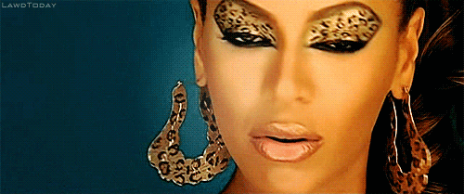
For 35 years I have wondered: Are women and animals real?
Notes:
Gif from Beyonce’s Kitty Kat videa

Slide 3
Of course, this was not the language I always used to ask this question.
It is probably most true to say that I always had a question.
But I wasn’t always sure what that question was.

Slide 4
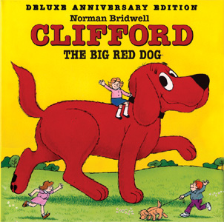
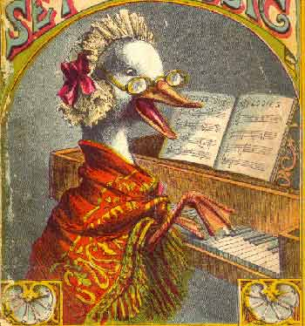
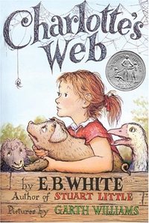
As a girl, I was obsessed with animals.
The world of the imaginary was the world of girls and animals.
Notes:
Clifford was the runt of a litter of puppies and was chosen by a city child named Emily Elizabeth as her birthday present. No one expected him to grow, but Emily's love for her tiny red puppy changed him dramatically. Before long, he was over 25 feet (7.6 m) tall, forcing the Howard family to leave the city and move to the open spaces of Birdwell Island.
The familiar figure of Mother Goose is an imaginary author of a collection of fairy talesand nursery rhymes^{[1]} which are often published as Mother Goose Rhymes.
Charlotte's Web is an award-winning children's novel by acclaimed American author E. B. White, about a pig named Wilbur who is saved from being slaughtered by an intelligent spider named Charlotte. The book was first published in 1952, with illustrations by Garth Williams.
The novel tells the story of a pig named Wilbur and his friendship with a barn spider named Charlotte. When Wilbur is in danger of being slaughtered by the farmer, Charlotte writes messages praising Wilbur (such as "Some Pig") in her web in order to persuade the farmer to let him live.

Slide 5
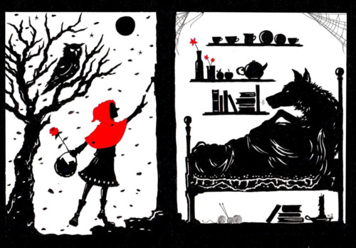
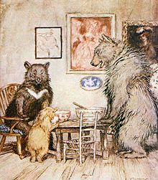
Little Red
Riding Hood
Goldilocks and the Three Bears
Notes:
Of course fairy tales also contain many conjugations of the woman and the animal. Cate Simmons
Little Red Riding Hood, also known as Little Red Cap, is a French fairy tale about a young girl and a Big Bad Wolf.

Slide 6
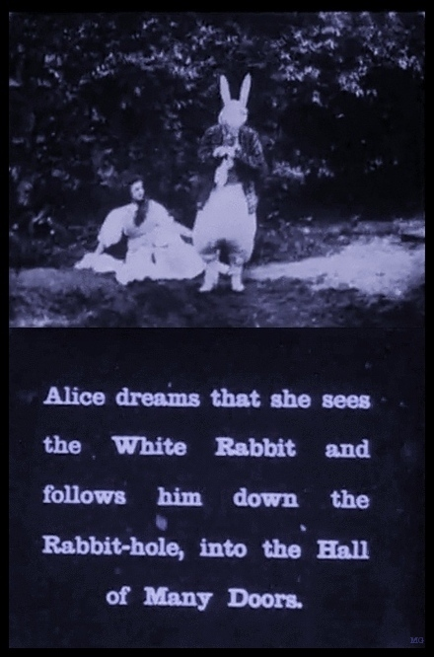
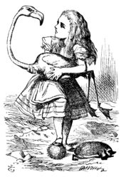
Alice In
Wonderland
Notes:
Down the rabbit hole into memory and loss. Into the imaginary, which is actually the real.
It tells of a girl named Alice who falls down a rabbit hole into a fantasy world(Wonderland) populated by peculiar, anthropomorphic creatures. The tale plays with logic, giving the story lasting popularity with adults as well as children.^{[2]} It is considered to be one of the best examples of the literary nonsense genre,^{[2][3]} and its narrative course and structure have been enormously influential,^{[3]} especially in the fantasy genre.

Slide 7
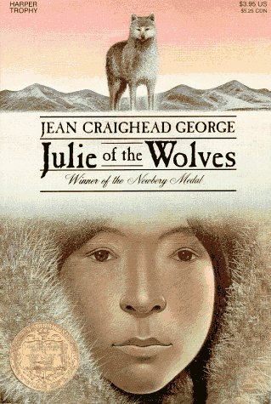
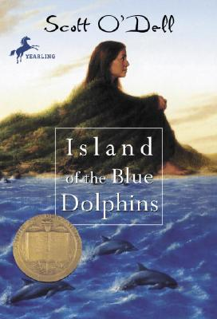
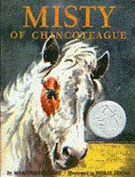
Survival and the “wild”
Notes:
And yet this imaginary world was also quite real. In fact, two of the books that were most important to me were inspired by real/true events
Julie of the Wolves is a children's novel by Jean Craighead George, published in 1972, about a young Yupik girl experiencing the changes forced upon her culture from outside. Miyax is alone in the wilderness studying the wolves. She has been alone for some time, and seeks help from the wolf pack and is gradually accepted into the pack. She studies the gestures and "language" of the wolves and learns to mimic them. In this way she gains acceptance as a part of the pack and is able to eat and stay alive.
Island of the Blue Dolphins: The story of a young girl stranded for years on an island off the California coast, it is based on the true story of Juana Maria, a Nicoleño Indian left alone for 18 years on San Nicolas Island in the 19th century. The main character is a girl named Wonapalei, and her secret name is Karana (all the people of Ghalas-at have secret names). Alone on the island, Karana must now take on traditionally male tasks, such as hunting, making spears, or building canoes, in order to survive. She vows to avenge her brother's death and kills several of the dogs, but has a change of heart when she encounters the leader of the pack. She tames him and names him Rontu, meaning "fox eyes" in her language. Over time, Karana makes a life for herself. She builds a home and even stocks a cave with provisions in case the Aleuts ever come back, so she can hide from them. As she explores her island, Karana discovers ancient artifacts and an octopus (which she calls a devilfish). As time passes, she decides to hunt the squid. She also tames some birds and an otter; she feels a close kinship to the animals, the only inhabitants of the island beside herself.
Misty of Chincoteague is a 1947 book by American author Marguerite Henry, inspired by a real Chincoteague Pony named Misty. Set on the coastal island of Chincoteague, Virginia, the book tells the story of the Beebe family and their efforts to raise a filly born to a wild horse.

Slide 8
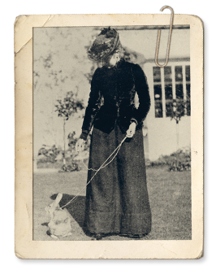
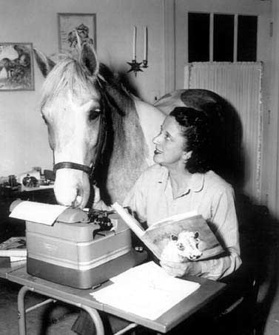
Marguerrite Henry & Beatrix Potter
Notes:
Writers with their animals. For me, the initial figure of the woman writer was the figure of a woman accompanied by animals. The woman writer’s connection to the animal was conjoined with her connection to expressive language.

Slide 9
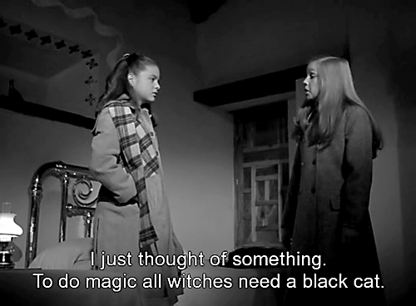
Animal Familiars
Notes:
Animal familiars
Veneno para las hadas, Carlos Enrique Taboada, 1984.

Slide 10
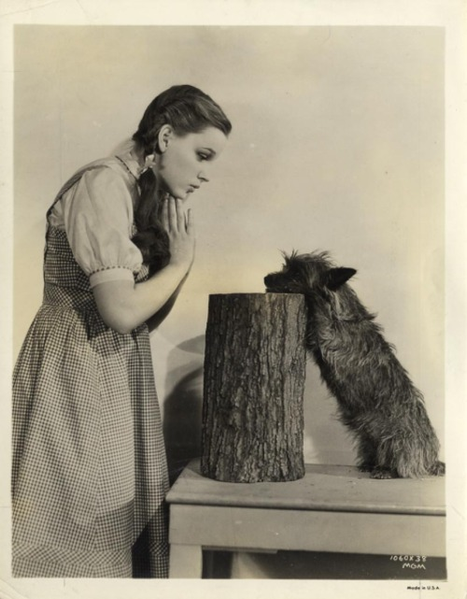
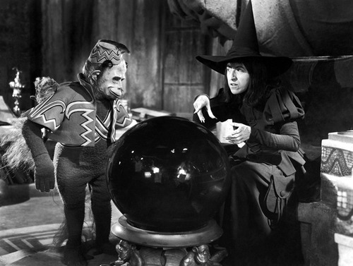
The Wizard of Oz
Notes:
Judy Garland and Terry The Dog
Publicity photo for The Wizard of Oz - (1939)

Slide 11
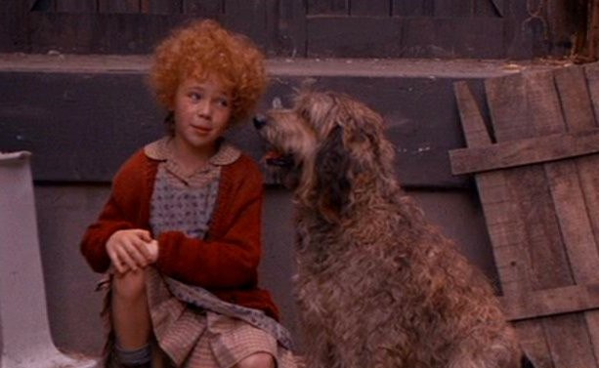
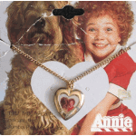
Annie

Slide 12
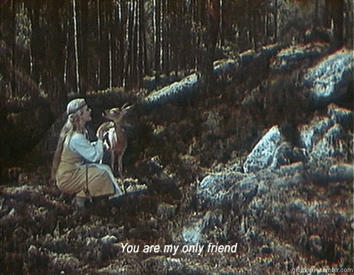

Slide 13
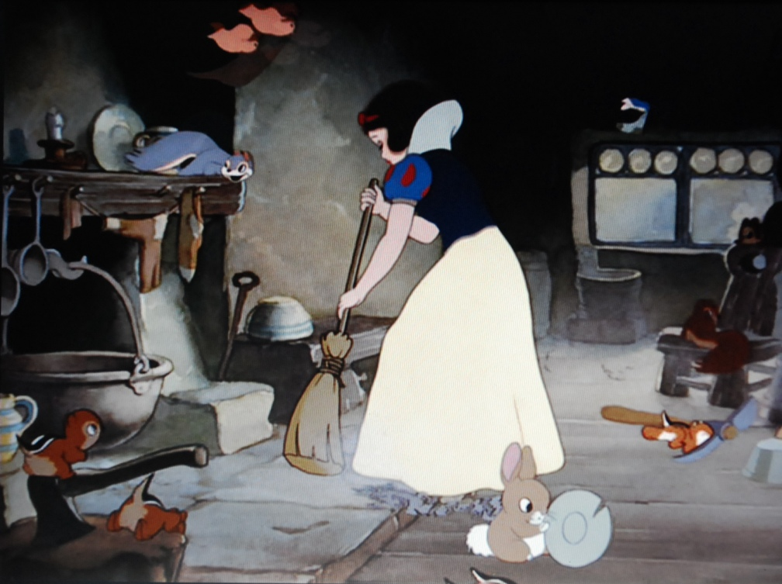

Slide 14
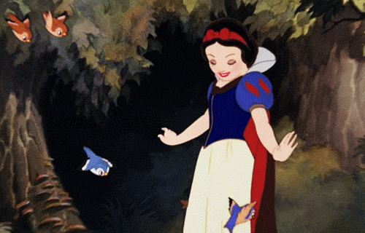
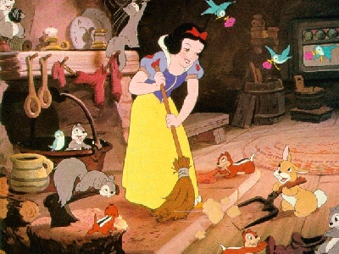
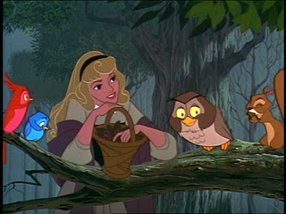
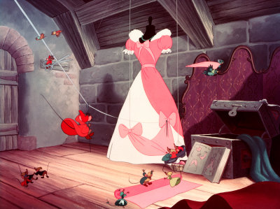

Slide 15
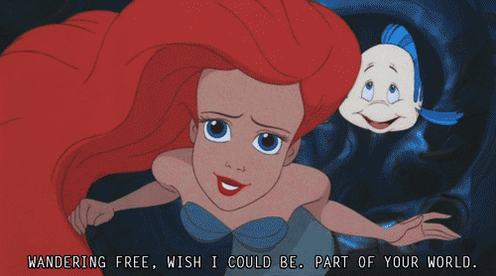
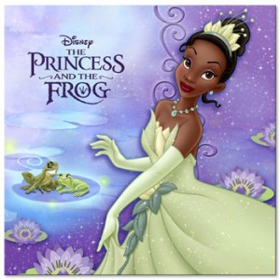
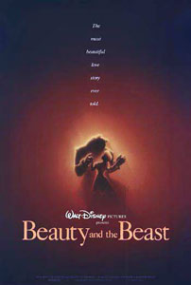
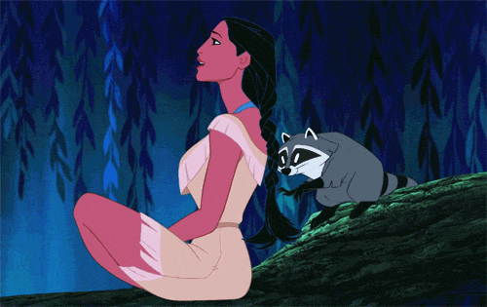

Slide 16
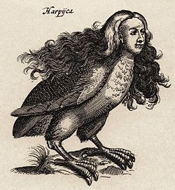
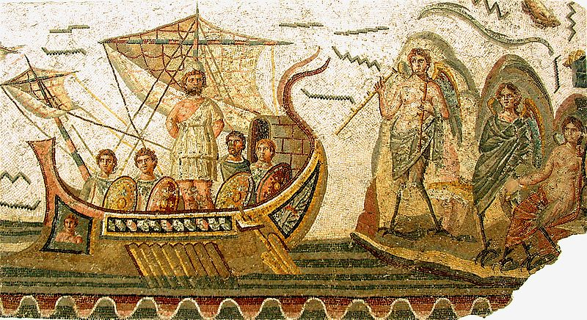
The harpy (“snatcher”) best known for constantly stealing food from Phineas
Sirens
Notes:
In Greek mythology, a harpy ("snatcher", from Latin: harpeia, originating in Greek:ἅρπυια, harpūia) was one of the winged spirits best known for constantly stealing all food from Phineas. The literal meaning of the word seems to be "that which snatches" as it comes from the ancient Greek word harpazein (ἁρπάζειν), which means "to snatch".
Sirens combine women and birds in various ways. In early Greek art Sirens were represented as birds with large women's heads, bird feathers and scaly feet. Later, they were represented as female figures with the legs of birds, with or without wings, playing a variety of musical instruments, especially harps. The tenth century Byzantine encyclopediaSuda^{[14]} says that from their chests up Sirens had the form of sparrows, below they were women, or, alternatively, that they were little birds with women's faces. Birds were chosen because of their beautiful voices. Later Sirens were sometimes depicted as beautiful women, whose bodies, not only their voices, are seductive.

Slide 17
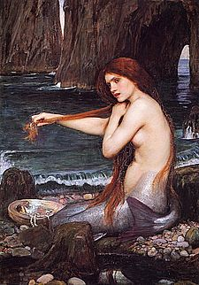

Mermaids
Notes:
A Mermaid
by John William Waterhouse

Slide 18
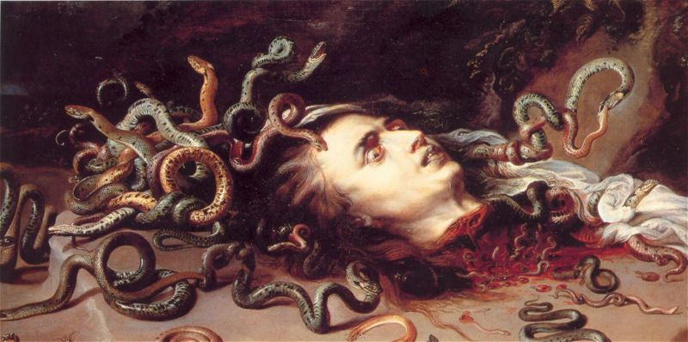
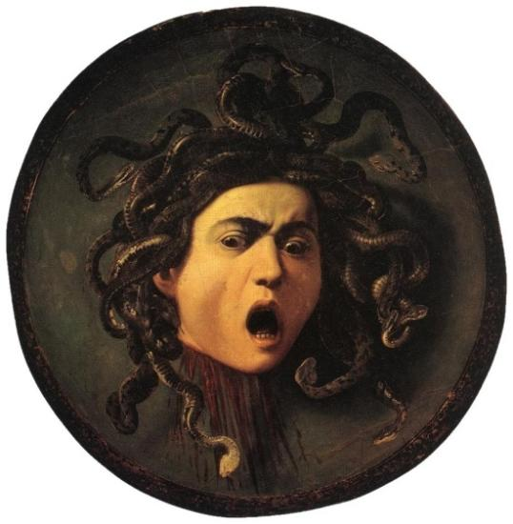
Tête de Méduse, by Peter Paul Rubens (1618)
Medusa, by Caravaggio (1595)
Notes:
Gorgons sometimes are depicted as having wings of gold, brazen claws, the tusks of boars, but most often with the fangs and skin of a serpent.
The story of medusa resonated with me, not only because she was monstrous, but also because it was her own reflection that caused her death. This reminds me of the sort of social training many girls get – they are trained to look in the mirror and criticize themselves. Medusa is supposedly mythic – not real – but her turning to stone, her transformation from angry serpent-headed monster to stone – seemed to signify as sort of becoming real of the most awful sort. Her power was turned against her. This is true of beauty. It might give you power, but does it make you real? And at what cost. Women are socialized – told repeatedly – that their beauty makes them powerful, but she must be modest and self-critical, and if she is not, then what seems to be in vague now is a sort of performed self-confidence that can easily tip into a sort of vapid vanity or a friable veneer. It is a brittle beauty. Is it real?

Slide 19
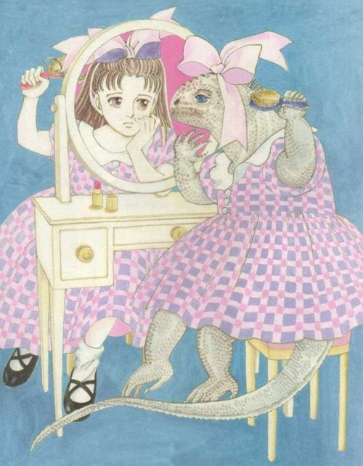
Iguana Girl
Moto Hagio
Notes:
It is about a young girl, Rika, whose mother views her as being ugly, and favours her other daughter, Mami. Rika thinks of herself as ugly and as an iguana, but after her mother's death, realises that her mother was also an ugly iguana.
Woman as animal as monster
Moto Hagio The term shōjo, shojo, or shoujo manga (少女漫画 shōjo manga?) refers to mangamarketed to a female audience roughly between the ages of 10-18. The nameromanizes the Japanese 少女 (shōjo), literally: "little female".

Slide 20
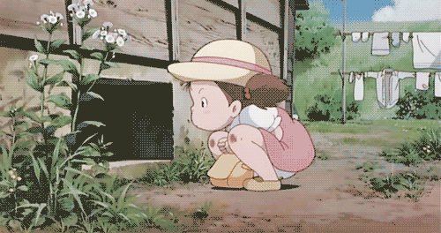
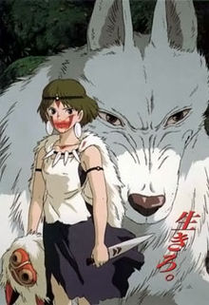
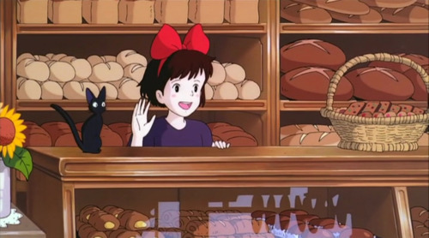
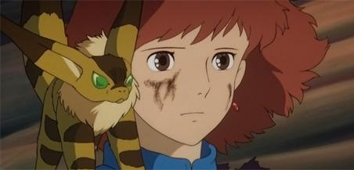
Miyazaki
Notes:
Miyazaki
My Neighbor Totoro (となりのトトロ Tonari no Totoro?), is a 1988 Japanese animatedfantasy film written and directed by Hayao Miyazaki and produced by Studio Ghibli. The film follows the two young daughters of a professor and their interactions with friendly wood spirits in postwar rural Japan
KIKI According to Miyazaki the movie touches on the gulf that exists between independence and reliance in Japanese teenage girls.^{[2]} Going far beyond coming of age themes, the work deals with the nature of creativity and talent, and the central difficulty every person faces in becoming themselves, whether through luck, hard work or confidence
The film tells the story of Nausicaä, a young princess of the Valley of the Wind who gets involved into a struggle with Tolmekia, a kingdom who tries to use an ancient weapon to fend off the Ohm Nausicaä (Sumi Shimamoto), a princess of the Valley of the Wind is a skillful fighter, but also humane and peace-loving. She communicates with the giant insects (Particularly the Ohmu, gigantic, armored, caterpillar insects who are the most intelligent in the Jungle.) s. Nausicaä must stop the Tolmekians from killing these insects.
Princess mononke Iron Town, located in that range, continually clears the nearby forests to make charcoal to smelt ironsand and produces advanced firearms, leading to battles with the giant forest beasts. Among these animals are giant wolves, who are accompanied by San (Yuriko Ishida), a human girl adopted by the wolves, whom the villagers of Iron Town call "Princess Mononoke."
.

Slide 21
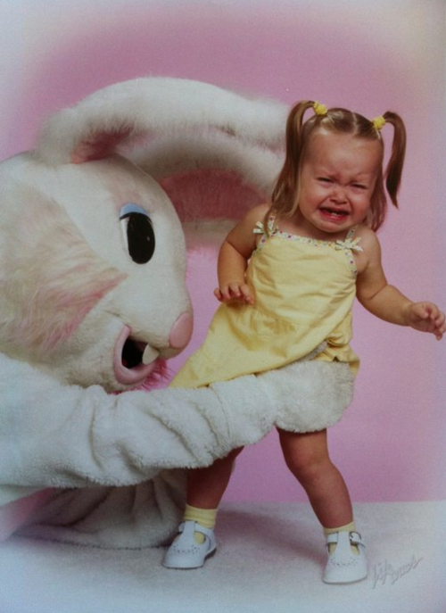
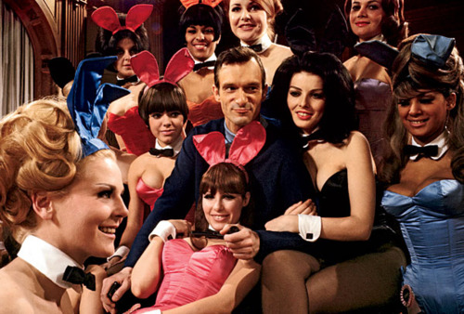

Notes:
Women and bunnies

Slide 22
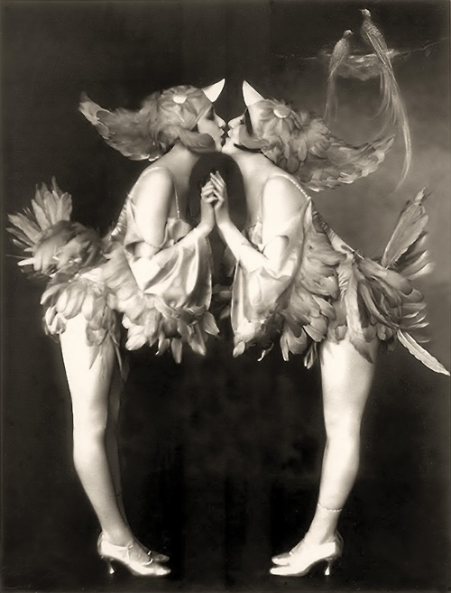
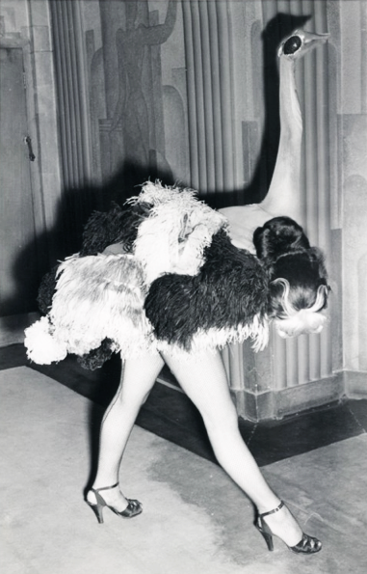
1951 “Ostrich” dancer in the Folies Bergere show at theLondon Hippodrome
Ziegfeld Girls; The Dolly Sisters

Slide 23
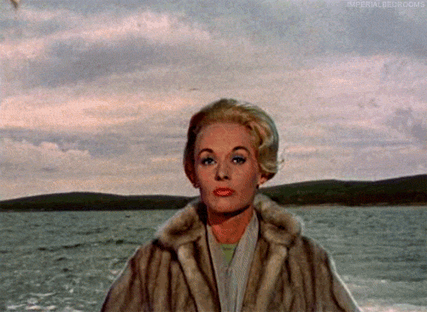
The Birds

Slide 24
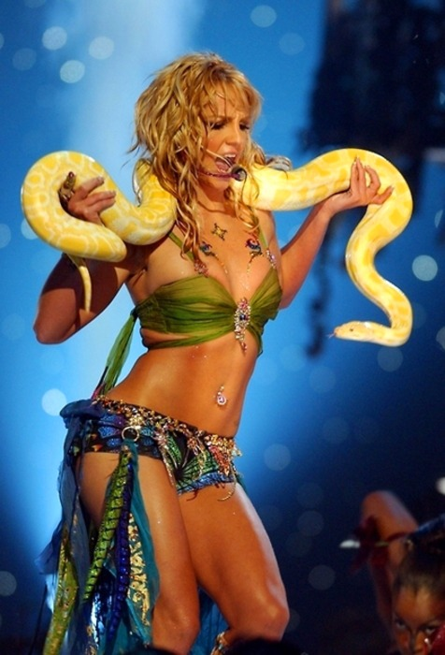
Britney
Notes:
Unreal …the need to be farbricated or authentic…Eve, the initial betrayal marked by her alliance/seduction by the animal.

Slide 25
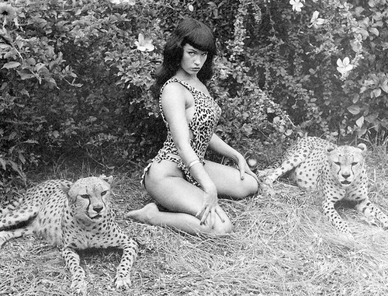
Bettie Page
Notes:
Madame Scheel by Fred Whitman

Slide 26
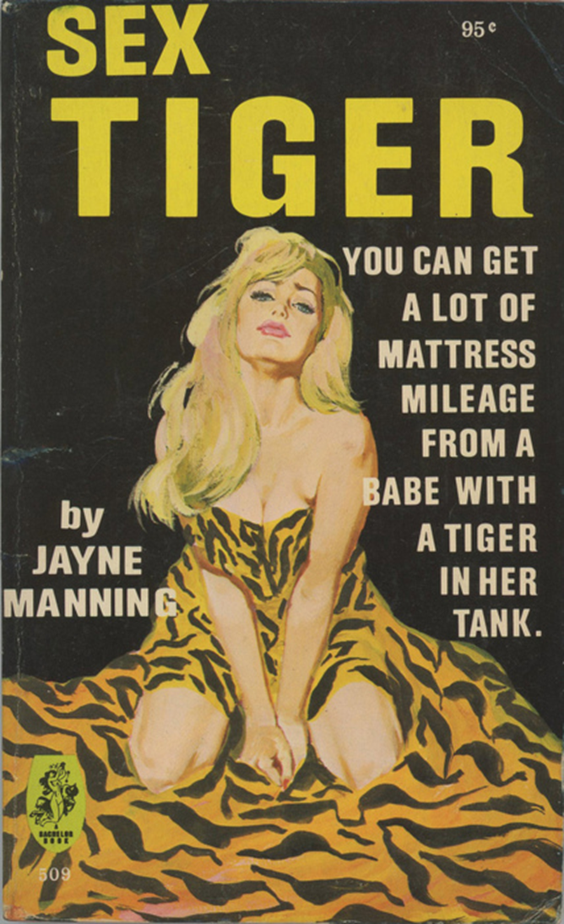
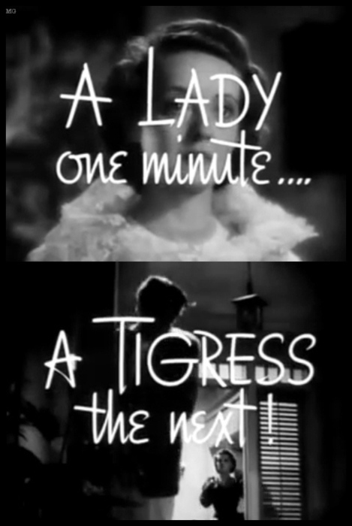
Notes:
Bette Davis - The Letter (1940)

Slide 27
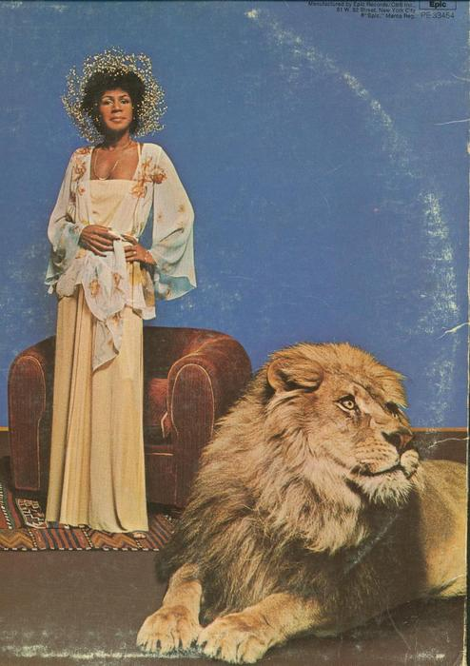
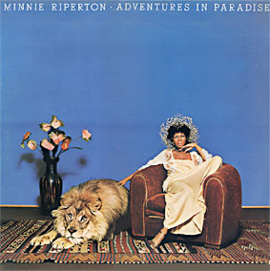
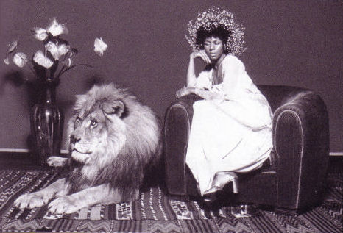
Minnie Riperton
Notes:
Minnie Riperton – interesting side note – riperton was actually nipped and pawed by a lion while doing a tv promo slot for this album. The tv spot was with a different lion. The lion in the photo is named simba. Also, Riperton could sing in a whistle register, and in the background of the video for “loving you,” she included the sounds of birds chirping and whistling.
The female voice is also of the animal, or of the unreal. Connects perhaps to the siren’s songs.

Slide 28


Slide 29


Slide 30

"Little" Edie Beale, Debutante-Turned-Cat Lady
Edith Bouvier Beale would never marry. Instead, Jackie Onassis' cousin (pictured in January 1972, at age 55) spends 25 years caring for her mother in a decaying mansion overrun with cats and filled with mounting piles of garbage.

Slide 31

Fashion Photography by Tim Walker

Slide 32



Slide 33



Slide 34


Alexander
McQueen
Notes:
Voss, Alexander McQueen S/S 2001

Slide 35


Notes:
Alexander McQueen Paris S/S 08 - Tanya Dziahileva

Slide 36



Slide 37


Riot Grrrl

Slide 38



Slide 39



Guerrilla Girls
Notes:
http://moderngirlblitz.tumblr.com/post/4558672658/meeeow-edit-this-cat-fucking-rules-by-the-way

Slide 40


Frida Kahlo
"The Little Deer" by Frida Kahlo, 1946
Notes:
Frida Kahlo and her pet deer Granizo, 1939, photographed by Nickolas Muray

Slide 41


Gertrude Stein and Basket

Slide 42


Virginia Woolf

Slide 43

“The large cat is like a spirit animal, a white tiger perhaps. The woman, a young Chinese student in the United States, figures that which is human, the universal, the generic. The "woman of color," a very paraticular, problematic, recent collective identity, resonates with local and global conversations. In this paintinig, she embodies the still oxymoronic simultaneous statuses of woman, "Third World" person, human, organism, communications technology, mathematician, writer, worker, engineer, scientist, spiritual guide, lover of the earth. This is the kind of "symbolic action" transnational feminisms have made legible, S/he is not finished.”
-Donna Harraway, from “The Promises of Monsters: A Regenerative Politics for Inapproriate/d Others”

Slide 44

Susan Sontag (in a bear suit)

Slide 45


Louise Bourgeois
Notes:
Louise Bourgeois [+] by Alex Van Gelder

Slide 46


Kiki Smith
Notes:
Kiki Smith (born January 18, 1954, in Nuremberg, Germany) is an American artist classified as a feminist artist, a movement with beginnings in the twentieth century. Her Body Art is imbued with political significance, undermining the traditional erotic representations of women by male artists, and often exposes the inner biological systems of females as a metaphor for hidden social issues. Her work also often includes the themes of birth and regeneration, as well as sustenance, and frequently has Catholic allusions.

Slide 47




Lorna Simpsom
Notes:
You're Fine, 1988, 4 color Polaroid prints, 15 engraved plastic plaques,
21 ceramic pieces (19 letters, 2 apostrophes). 40 x 103 inches overall.
Simpson's 1989 work, Necklines, shows two circular and identical photographs of a black woman's mouth, chin, neck, and collar bone. The white text, “ring, surround, lasso, noose, eye, areola, halo, cuffs, collar, loop”, individual words on black plaques, imply menace, binding or worse. The final phrase, text on red “feel the ground sliding from under you,”openly suggests lynching, though the adjacent images remain serene, non-confrontational and elegant.^{[4]}
PARTS TEXT PANEL:
As they reached the Bronze period-the second to last room, they observed that all the visitors had securely fastened their headsets and moved from object to object, completely oblivious to any ambient sound. Their gaze and pace was guided by the tapes. There was the possibility that no one would notice except maybe the guards, but they did not wander far from the large groups with headsets. Generally, museum-goers feel it is more efficient to work their way from the top down. In the past, staircases were the ideal location; the landing just above the exit door to the top floor of the exhibition space worked well, and if people could hear you they would maybe stop and listen, but would not venture to look. Therefore, hardly anyone went beyond this point to the next landing, and staff rarely used the public staircase. Unfortunately, this institution did not have that vertical expanse.

Slide 48

Carlee
Fernandez
Notes:
Fernandez’ sculptural and photographic work transforms natural objects such as taxidermy animals or human bodies into new configurations that challenge the boundaries of singularity and formal distinction by blurring traditional epistemological categories. Christopher Knight, writing in the Los Angeles Times, remarks that her ensembles “mix reverence for the natural world with art’s imaginative wildness, trading conceptual places in unexpected ways.” Binary categories such as animal/human, femininity/masculinity, instinctual survival/cultural constraints, beauty/grotesque or death/life are unsettled in works which address, as Marlena Doktorczyk-Donohue comments in Art Ltd., “a rhizome of rich ungoverned allusions to many related things: to biology, biography, family, identity and lineage.”

Slide 49

“Que le cheval vive en moi”
(May the horse live in me)
Marion Laval-Jeantet and Benoît Mangin

Slide 50

“In February 2011, having progressively built up her tolerance to the foreign animal bodies, she was injected with horse blood plasma containing the entire spectrum of foreign immunoglobulins….”
Notes:
, without falling into anaphylactic shock, an acute multi-system allergic reaction.

Slide 51

"I had the feeling of being extra-human,“ explained the artist. "I was not in my usual body. I was hyper-powerful, hyper-sensitive, hyper-nervous and very diffident. The emotionalism of an herbivore. I could not sleep. I probably felt a bit like a horse.'

Slide 52
Thank You

